Slide 1
3. Robot Control
3.1 Fundamentals
3.2 Single-joint Control
3.3 Computed Torque Control
3.4 Lyapunov Stability Analysis
3.5 Adaptive Control
- 0 -

Slide 2
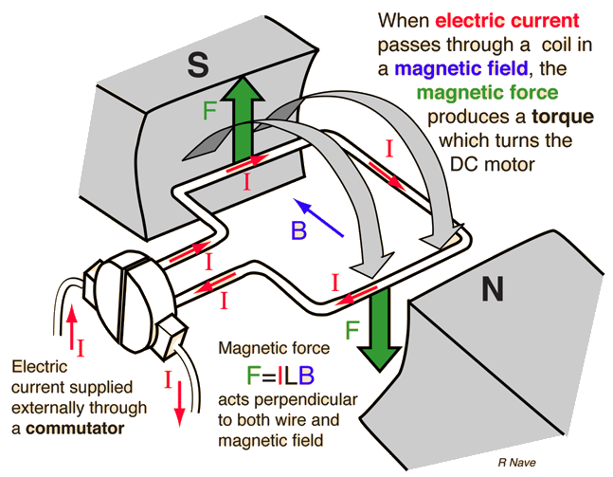
3.2 Single-joint Control
3.2.1 Modeling of a Single Joint
Case Study: DC (Direct Current) Torque Motor
Many industrial robots use DC (Direct Current) Torque Motors
which consist of stators, rotors and armatures (various windings):
- 1 -

Slide 3
3.2 Single-joint Control
Generally, the relationship between the current and the torque produced is
When a motor rotates, a voltage develops across the armature. The voltage generated for a given rotational velocity is
Motor Torque Constant
Back EMF (Electromotive Force) Constant
- 2 -

Slide 4
3.2 Single-joint Control
3.2.2 Motor Armature Inductance
The electric circuit of the armature is shown in the figure.
The circuit is described by
: Source voltage
: Inductance of the Armature Windings
: The Current
: Resistance of the Windings
The net effect is that of a low pass filter between the requested voltage and output torque.
- 3 -

Slide 5
3.2 Single-joint Control
Assume that the motor inductance is negligible, then
Pure torque source
Viscous friction
- 4 -

Slide 6
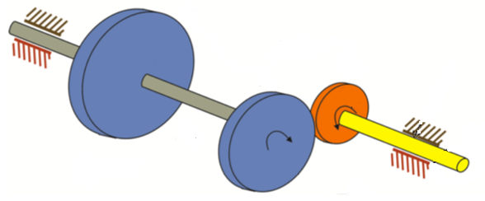
3.2 Single-joint Control
3.2.3 Effective Inertia
The mechanical model of the rotor of a DC torque motor connected through a gear to an inertial load is shown in the following figure.
I : Load Inertia
I_{m} : Rotor Inertia
- 5 -

Slide 7
3.2 Single-joint Control
The gear ratio causes an increase in torque and a reduction in speed at the load:
A torque balance at the rotor gives
- 6 -

Slide 8
3.2 Single-joint Control
Or in terms of load variables
Remark:
Effective Inertia
Effective Damping
Note: Direct Drive Robot
- 7 -

Slide 9
3.2 Single-joint Control
To ensure that the motion of the robot link is never undamped, the value for I should be the maximum value, . This choice will result in a system that is critically damped or over-damped in all situations.
The system is modeled under the assumption of rigid linkages. In reality, every element has finite stiffness.
However, if the system is sufficiently stiff, the natural frequencies of these unmodelled resonances are very high and can be neglected compared to the influence of the dominant second-order poles that we have modeled.
- 8 -

Slide 10
3.2 Single-joint Control
A rule of thumb is that if the lowest structural resonance is
, then we must limit the closed-loop natural frequency
according to
Typical industrial manipulators have structural resonances in the range of 5Hz-25Hz.
Direct Drive robots can have the lowest structural resonance as high as 70Hz.
- 9 -

Slide 11
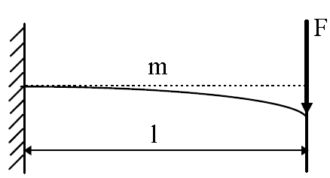
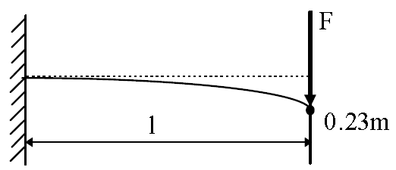
3.2 Single-joint Control
3.2.4 Estimating Resonant Frequency
As a rough estimation of the stiffness, a single link can be modeled as a cantilever beam, and calculate the stiffness at the end point.
For a round hollow beam,
inner diameters
outer diameters
- 10 -

Slide 12
3.2 Single-joint Control
For a square-cross-section hollow beam
Approximate natural frequency can be obtained by a equivalent simple spring mass system
W. Book suggested to use a lumped model of mass to roughly estimate the lowest resonance frequency
outer widths
inner widths
the equivalent mass displaced in vibration
- 11 -

Slide 13
3.2 Single-joint Control
3.2.5 Control of a Single Joint
Usually, we have the following assumptions:
The motor inductance can be neglected, i.e., the motor is a pure torque source.
Taking into account high gearing, the effective inertia is modeled as a constant
Structural flexibilities are neglected except that the lowest structural resonance is used in setting the servo gains.
The control design is carried out for the system.
- 12 -

Slide 14
3.2 Single-joint Control
Using the partitioned control
The resulting closed-loop dynamics are
(See Eq. 3.1.1)
(See Eq. 3.1.2)
- 13 -

